Slide 1
Error Code Small Group
AIRA

Slide 2
Discussion
Jane Lammers

Slide 3
Scope
In Scope
ERR-5: Adding new codes to list
Minor changes to existing codes possible
Most common and fatal errors Need this information from the group.
Criteria for adding new codes (how specific / generic they should be)
Categorization, Tagging?
ERR-2 Could be used to provide context for generic concepts
Might be a strategy to combine specific / generic, levels, use both
Meta Information
Cross linking with Data Validation Guide (combined document) - Link to specific section in a guide, might also be conformance statement in IG
Flag items that are clinically possible so should not ever be hard errors
Perhaps provide guidance on valid/invalid severity codes?
Actor/Action – could get some feedback from IIP
Look at Actor terms/types, need to make sure the text makes sense for clinician?
ERR-9 Inform Person Indicator – if we could categorize we could message this, come up with suggested values (Stretch goal, if we have time)
Future Work
ERR-7 Diagnostic Information
ERR-8 User Message
QBP related errors
Out of Scope
ERR-4 Severity – determined by IIS at run time
ERR-3 HL7 Error Code – set by HL7, we can’t change it
Notes:
The champion should propose to the group an initial scope. The group should discuss, but this does not have to be finalized in the Kick Off meeting. If the discussion lasts for more than 10 minutes then the discussion will continue on the first call of the group. It usually takes two meetings to get the scope set for sure.

Slide 4
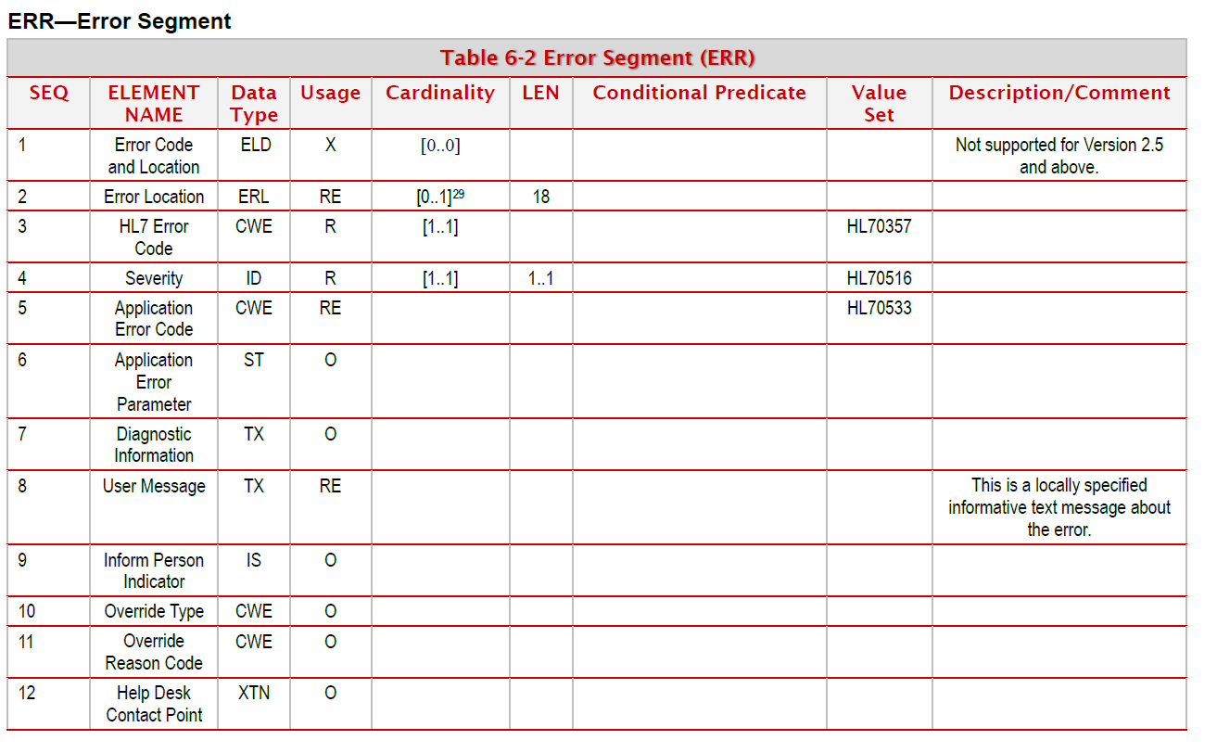

Slide 5
Task Participants
Guidance Document | Test Cases | Technical Demonstrations
Chrissy Miner Craig Newman Maia Ouderkirk | Jane Lammers Jason Suchon Heather Crawford Lori Reed-Fourquet | Kevin Snow Danny Wise Stephen Hill

Slide 6
Deliverables
Guidance
Guidance Document
Compiled Error Codes
Test Cases
AART Data Quality Section
Software Demonstration
Message Quality Evaluator (MQE)

Slide 7
Deliverables
Area | Deliverable | Notes
Guidance | Updated Guidance Document Need guidance on what needs to be added Updated spreadsheet of codes Focus on common fatal | All: Please read guide before next call Send most common/fatal errors
Test Cases | AART has test cases Work from Google spreadsheet Update and add items Prioritize (high, medium, low) | Will need to add columns to spreadsheet to coordinate progress
Software Demonstration | MQE Tool Envision WebIZ Error Analysis Compare ACKs, make them more consistent EHR Generic Requirements for ACK processing

